Slide 1

DCIT 204 SEMESTER PROJTECT- GROUP 20

Slide 2
GROUP MEMBERS | ID
Kwakye Sampson Boaf | 10978446
Abigail Edem Hayibor | 10976187
Daniella Asiedu | 10976807
Asiedu Chris Kwame | 10980023
Daniel Koomson | 10966669
David Sompa Asomani | 10951236
Kuvor Philander Edem | 10974577
Oheneba Vicent Dzifa | 10983369
Seth Ocansey | 10953450

Slide 3

ABOUT
The project focuses on a web app showing the fastest and shortest route on the University of Ghana, Legon campus from Location A to Location B. for example, from the Sarbah Hall to the Political Science department.

Slide 4

HOW THE WEB APP WAS CREATED
The team used the IntelliJ IDE for the entire work and its deployment.
All other files included can be found in the attached github repository.

Slide 5

HOW IT WORKS
On running the codes, the user will have to enter the current location, main entrance, and the destination, UGCS
After, the user must then click on the routes whether he/she wants the best route, or the fattest route, and the web app will provide the user with landmarks and other alternative route.
If possible, the user must enter a landmark query to be given the landmark location and how it will help the user locate UGCS.

Slide 6
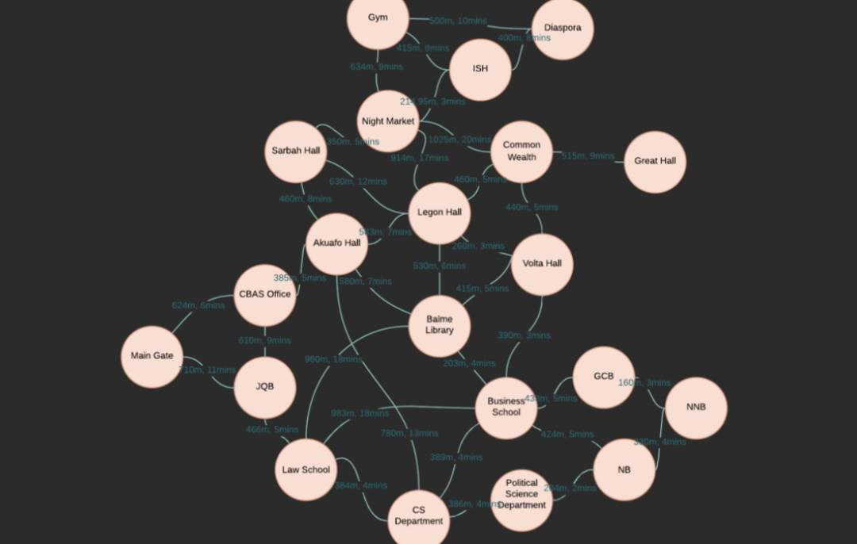
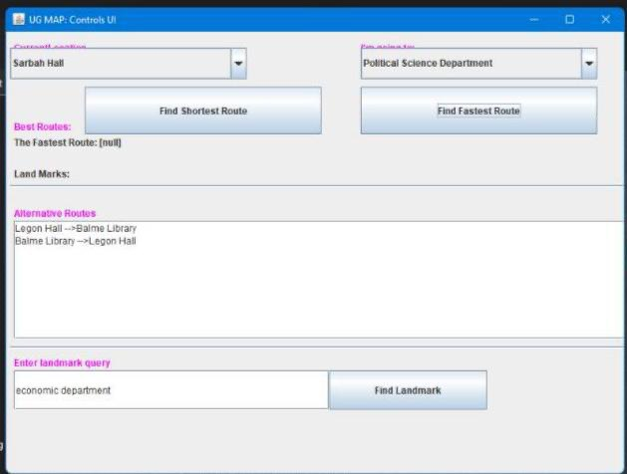
SOME IMAGES OF THE WEB APP

Slide 7

Link to the Github repo.
https://github.com/VinandoGH/DCIT-204--navigation-App1.git

Slide 8

REFERENCES
Bullinaria, J. (n.d.). Lecture Notes for Data Structures and Algorithms Revised each year. https://www.cs.bham.ac.uk/~jxb/DSA/dsa.pdf
Luca, G. B., & Tongo, D. (n.d.). DSA Data Structures and Algorithms Annotated Reference with Examples. http://dotnetslackers.com/ & https://www.mta.ca/~rrosebru/oldcourse/263114/Dsa.pdf
Fox, C. (n.d.). Concise Notes on Data Structures and Algorithms Ruby Edition. https://w3.cs.jmu.edu/spragunr/CS240_F12/ConciseNotes.pdf

Slide 9

THANK YOU

